Slide 1
Year-End Roadshow 2024: Financial Assurance

Slide 2
Agenda
Departmental Financial Self-Assurance Return 2024
Purchasing hierarchy project
Contacts

Slide 3
Departmental Financial Self-Assurance Return 2024

Slide 4
Financial assurance framework
THIRD LINE OF DEFENCE
Internal audit
Self-Assurance
SECOND LINE OF DEFENCE
Assurance check by depts/divs/Finance:
Encouraging departments and divisions to assure themselves that they have adequate arrangements in place to deliver their responsibility to operate an effective system of internal control, overseen by Financial Assurance.
FIRST LINE OF DEFENCE
Controls operated by depts/divs/Finance:
Operational delivery split between departments, divisions and the Finance Division, with teams responsible for operationalising their own processes in line with the control framework to manage risk.
BASELINE
Well designed and communicated financial processes:
The University (via Finance with consultation and committee oversight) designs and communicates processes and guidance to ensure an effective framework of financial control that manages risk specific to the University’s business and operating model.

Slide 5
Aims of Self-Assurance
Departments: Assurance
Finance: Communication
Highlight key processes and controls with links to information
University: Assurance
Annual communication and review
Departmental declaration
Assurance over certain controls
Reflect on how you manage risk
Assess internal control environment
Identify areas for action
Share good practice
Risk-based questions
Understand where we need to do more

Slide 6
Reflecting on the 2022/23 return
Nintex to Qualtrics (via Zill)
It did the job but had a number of failings:
SSO access issues for some Approvers
workflow email notifications (financial.assurance@qemailserver.com)
disliked ‘enter’
fragmentation of question sets due to text box auto-population
Reviewers/Approvers only seeing selected responses

Slide 7
The 2023/24 return
Zill working on the technical challenges
Limited changes to the question set:
focus on conflict of interest
reflected the purchasing threshold and process changes
assurance around use of the Checking Employment Status for Tax (CEST) tool
research project encouraging use of the Project Actions Tool (PAT)
desire to minimise cash handling
Please notify financial.assurance@admin.ox.ac.uk of changes to coordinators or approvers.
Deadline: 30th Sept
Notes:
Niamh Young – Assurance Directorate

Slide 8
Roles in Self-Assurance
Coordinator – administrative lead for financial administration; usually the Head of Administration and Finance (pre-populated)
Completers – managed by the Coordinator within Qualtrics (optional, up to 5)
Reviewer – an additional pre-approval review step managed by the Coordinator within Qualtrics (optional)
Approver – accountable for financial administration; usually the Head of Department, Faculty Board Chair or equivalent (pre-populated)

Slide 9
Accessing the return
On go live, Coordinators will receive two emails:
Set-up: to add or amend Completers and Reviewers
Added Completers will receive an email containing the access link and unique FSA password.
Added Reviewers will receive an email notifying them of their inclusion. A link to the review view will be granted, via email, once the return is submitted.
Access to the return: a link to Qualtrics and a unique FSA password
Approvers will only receive an email once the return has been submitted for their review and approval. This will contain a link to the review view of the return and is accessed via SSO verification.
Unless already logged in, you will also be prompted to enter your SSO credentials
Recommendations:
Keep your code easily accessible
Completers can submit a return for approval and so a Coordinator may wish to occupy a vacant Reviewer position
Engage Approvers early in the process
Notes:
Note: Reviewers and Approvers cannot amend the return itself.

Slide 10
Completing the return
Navigation
Tracking
Notes:
Index for ease of navigation and mandatory question tracker to visually identify completed/missed questions.

Slide 11
Completing the return
Each section includes:
1) Communication of good practice:
An overview of the key process elements and controls.
If relevant, new areas are highlighted.
Links are embedded.
2) Questions
Note: the return can be kept as a reference document and used at any time of year.

Slide 12
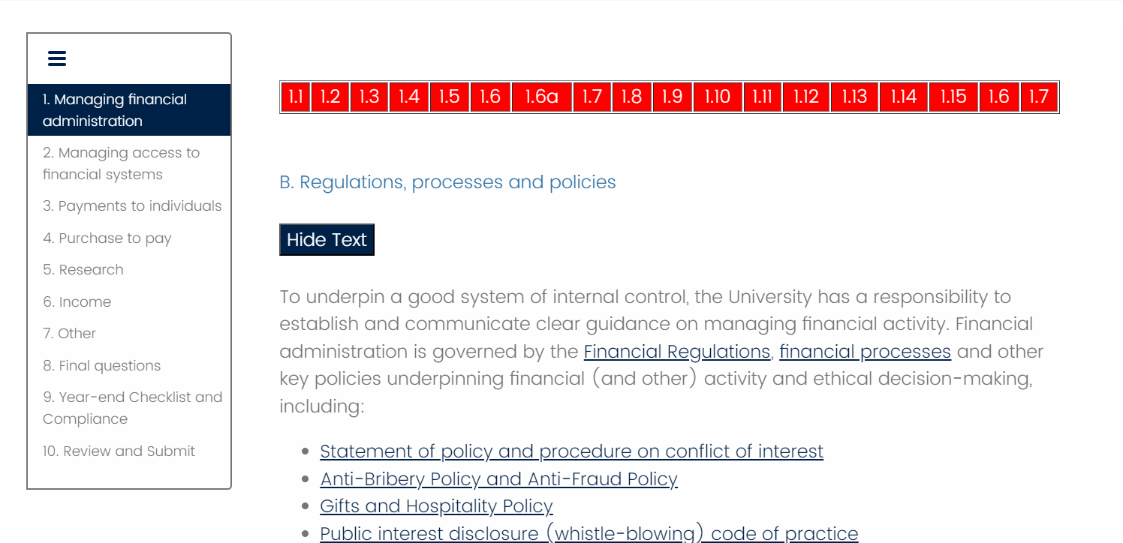
Completing the return

Slide 13
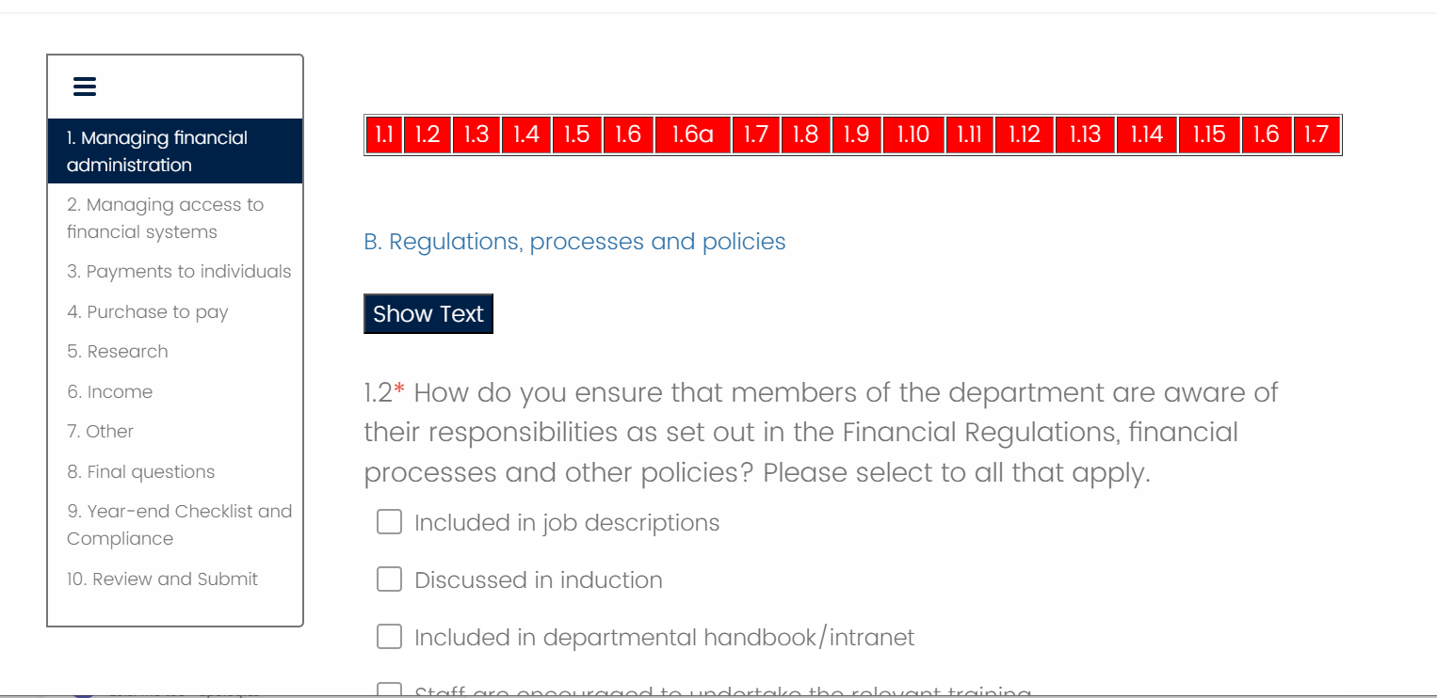
Completing the return

Slide 14
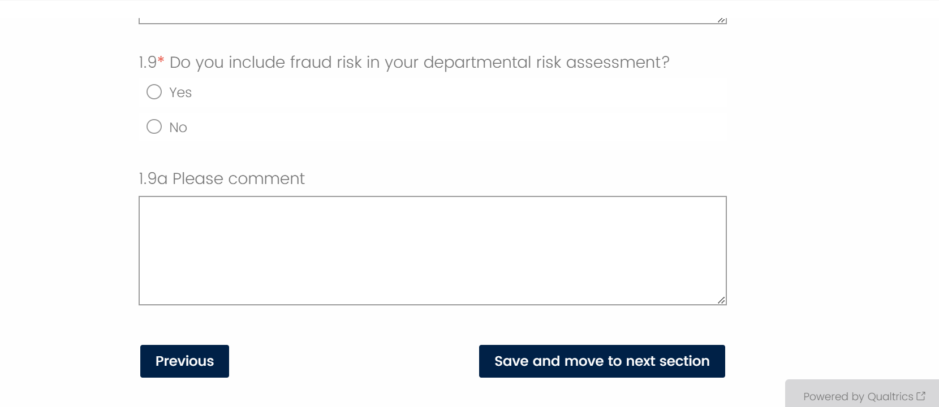
Completing the return
Save action required: To save you must click ‘Save and move to next section’
Notes:
Although sessions do not time out (like Nintex used to) we recommend saving regularly in case of internet connectivity issues, etc. Sadly ‘save’ alone isn’t an option in Qualtrics and so you must “save and move to next section” and then hit “previous” to achieve this.

Slide 15
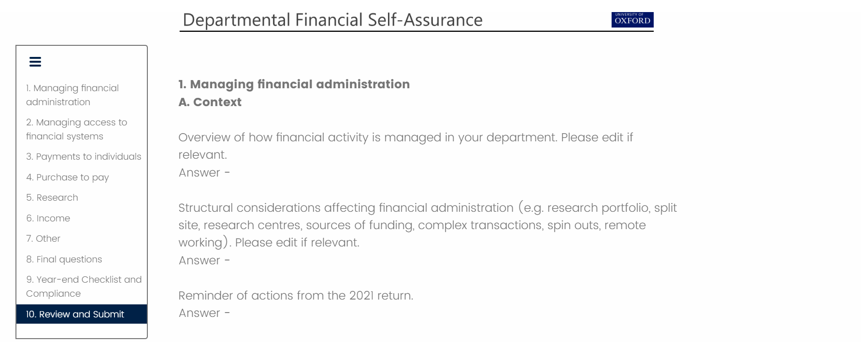
Submission and approval
Summary of mandatory questions
If all complete, you have the option to submit for review or approval
Notes:
Note the double check on submission – would you like to submit, are your sure you want to submit!

Slide 16
Timetable
July 2024:
Please let us know of any updates to your HAFs/HoDs as Coordinators and Approvers are pre-loaded into the return – email financial.assurance@admin.ox.ac.uk
PDF of prior year return can be requested from financial.assurance@admin.ox.ac.uk
August 2024:
Courtesy emails sent to Coordinators and Approvers
Coordinators receive launch emails
Coordinators set-up Completer (max 5) and Reviewer roles
August/September 2024:
Completion of the return
Liaise with head of department around approval
Annual reminders of key policies circulated
Optional review step
Approval
Deadline - 30th September 2024

Slide 17
What happens next
Financial Assurance activity:
Analysis of returns
Reporting to Audit and Scrutiny Committee (Nov)
Consult with Internal Audit (Nov)
Reporting to Process Oversight Groups and colleagues in the Financial Division
Development of annual priorities drawing on:
Self-assurance analysis
Data analysis
Internal, external and research audit reports
Sharing feedback and priorities with departments through:
Divisional presentations
Annual programme of departmental visits

Slide 18
Purchasing hierarchy project

Slide 19
What?
Project to review and improve how we operate purchasing approvals at the University
Forms part of our People and Finance Service Transformation programme (PFST)
First phase: focus on understanding the art of the possible with our current and future technology as well as understanding the current state through consultation with our department and Finance Division stakeholders.

Slide 20
Why?
Limited opportunities for budget-holder approval resulting in difficulties for PI’s and budget holders needing appropriate oversight
Off-system approvals or parallel processes being put in place to navigate overly simplistic and ridged position hierarchies
Multiple Oracle logins needed for staff working across differing areas, making it harder to work collaboratively and make most efficient use of Oracle to support our purchasing processes
Limitations in the system and small finance teams mean some individuals require self-approval access which poses risk and requires retrospective action by departments
Difficulties with split coding leading to the need for retrospective journaling.
Unclear understanding of how approvals operate within Buyer Work Centre
Notes:
Approval of purchases is a key financial control​
Since Oracle R12.1 implemented in 2013, our ways of working have changed!​
R12.2 implemented 2022, has brought to light some unexpected system behaviour​
Issues identified with approvals during P2P PUG meetings in 2023​
Since you have raised these issues, we are proactively working to collaborate with you to design a solution that will serve us into the future

Slide 21
Have your say…
Please sign up!
Notes:
There are four identical sessions with options for central Oxford and Headington. Please attend at the location that that suits you best (whether convenient to your home or usual place of work). The workshops will be in-person. Tea/coffee will be provided.

Slide 22
Help and support
Financial Assurance: financial.assurance@admin.ox.ac.uk
Finance Process Oversight Groups: finance.pogs@admin.ox.ac.uk
Counter-Fraud counterfraud@admin.ox.ac.uk

