Slide 1

Forecasting- Best Practice
Hints and Tips

Slide 2
Budgeting and Forecasting- what’s the difference? And why do it?
Q1 Aug - Oct
Q2 Nov-Jan
Q3 Feb-Apr
Q4 May - July
Year end
31st July
Year end
reporting
Q1 Forecast
Q2 Forecast
Q3 Forecast
Budget Preparation
Budgeting and forecasting help us to allocate resources effectively and improves decision making
Reduces impact of “surprises” in the system
Identifies changes to plans
Forms the basis for budgets
Highlights areas which may need support or who are delivering above expectations
Divisional Offices support the forecasting process

Slide 3
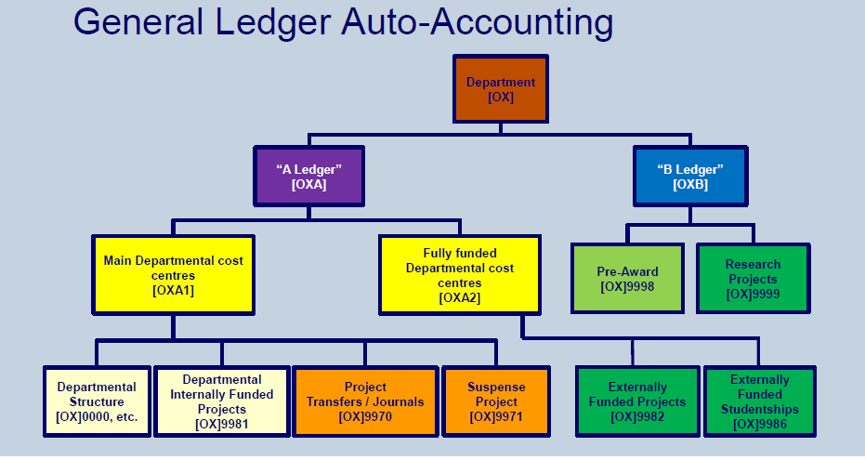
Budgeting and Forecasting- where is it done?
The A1 ledger relates to departmental activity and is the focus for budgeting. Forecasting can be done at the Departmental A1 level or cost centre by cost centre.
The A2 (departmental projects) and the B ledger (Research) should have a net nil impact on departmental finances as they are funded separately

Slide 4

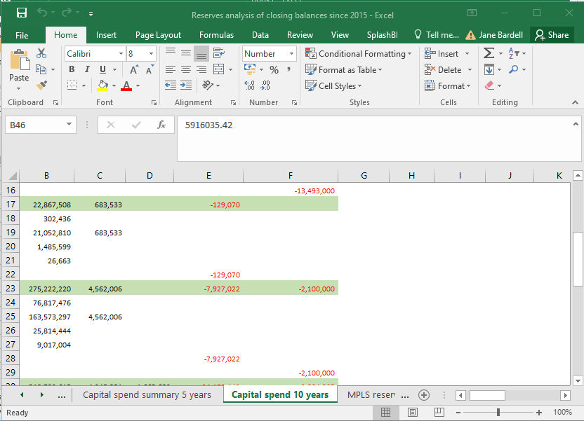
How did we used to provide forecasts?
Forecasts pre 2017 were prepared on multiple worksheets and manually combined at Divisional level
Payroll data
Core HR
Oracle
General Ledger
Actuals
Multiple Department worksheets
Forecast data
Combined data
Notes:
Before the budgeting and forecasting tool, data was pulled into spreadsheets from Core HR and Oracle, updated for forecasts and then fed back into Oracle.

Slide 5
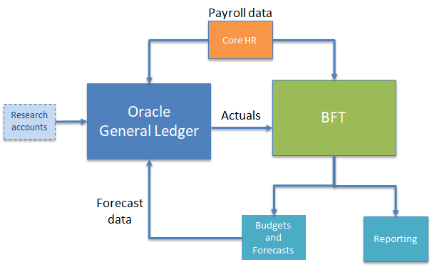
What is the BFT and how did it help?
The budgeting and forecasting tool (BFT) was introduced to reduce complexity, increase consistency, provide reporting and improve links to the Oracle General Ledger and Core HR payroll system

Slide 6
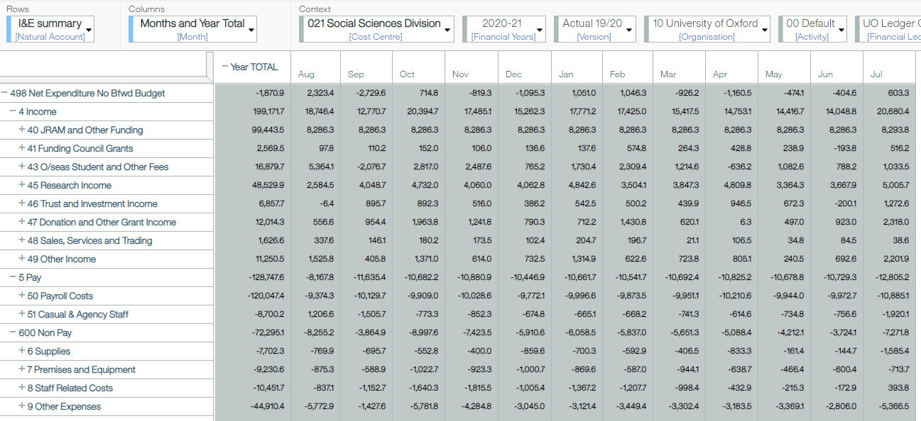
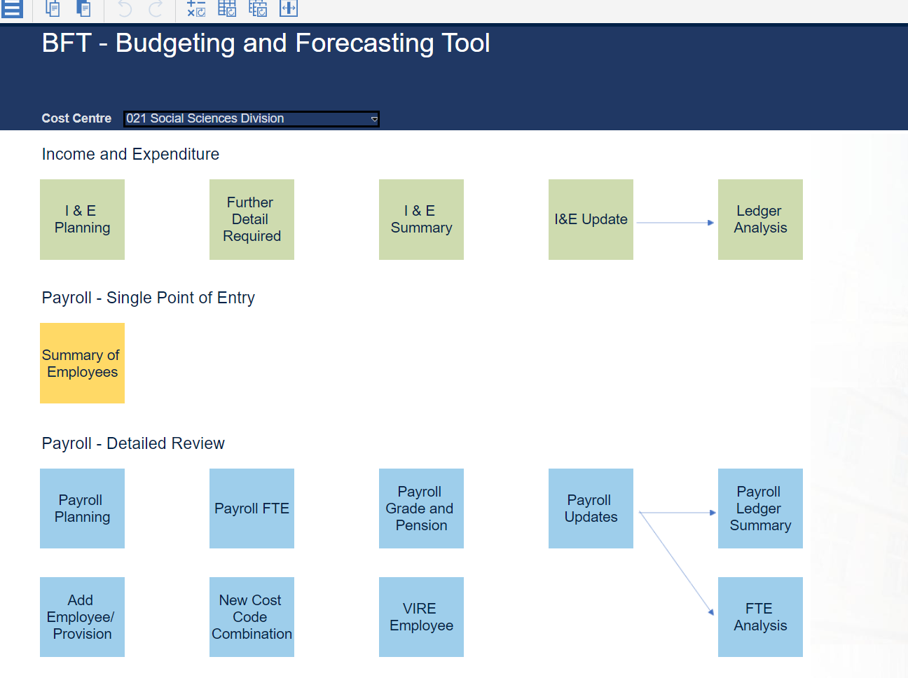
BFT reporting
BFT updates with actuals on a monthly basis and so is the best way to keep track of variances to budget even outside of the budgeting cycle

Slide 7
BFT Timelines- What happens when?
Q1 – 3:9 with budget pre-population
Basis of preparation
 | Aug | Sept | Oct | Nov | Dec | Jan | Feb | Mar | Apr | May | Jun | Jul
 | Act | Act | Act | Bud | Bud | Bud | Bud | Bud | Bud | Bud | Bud | Bud
Key review point for re-visiting forecast in light of prior year actuals
Q2 – 6:6 with Q1 forecast pre-population
 | Aug | Sept | Oct | Nov | Dec | Jan | Feb | Mar | Apr | May | Jun | Jul
 | Act | Act | Act | Act | Act | Act | Q1 Fcast | Q1 Fcast | Q1 Fcast | Q1 Fcast | Q1 Fcast | Q1 Fcast
Q2 is the basis of the budget so needs to be robust
Q3 – 9:3 with Q2 pre-population
 | Aug | Sept | Oct | Nov | Dec | Jan | Feb | Mar | Apr | May | Jun | Jul
11/5 Hard | Act | Act | Act | Act | Act | Act | Act | Act | Act | Q2 Fcast | Q2 Fcast | Q2 Fcast
Q3 is an early warning for year end issues
BFT is pre-loaded with all the assumptions you need including pay rates, NI etc

Slide 8
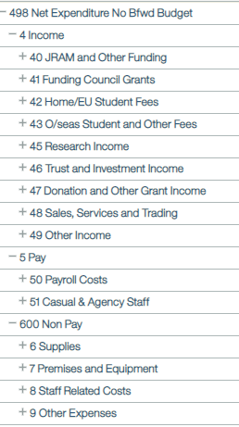
What’s included in the I+E?
Notes:
This is a screen shot of the income and expenditure statement in BFT

Slide 9
Where is best to start?
The approach to starting a Budget or a forecast is similar. Forecasting will be easier as you can use your Budget as a guide.
The finance team within a Department would usually coordinate with other key members of staff to gain the level of insight needed to complete the forecast. This could be HAFs, HODs, PIs, building managers etc.
Approach your forecast on a line by line basis and use the timetable given by your Division to determine which areas to focus on first.
Notes:
HAF – head of administration and finance
HOD – Head of Department
PI – Principal Investigators

Slide 10
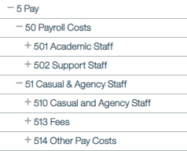

Slide 11
Staff Costs- a first area of focus
Staff costs include:
    Academic Staff
    Support Staff
    Casual & Agency Staff
Liaise with your HR contact of Business Manager to check FTE's, noting:
    Leavers – name and role number
    Starters – name, role number, grade and start date
    Known FTE changes
    Known Grade changes (not including the yearly incremental increase)
Pay awards and increments are put through centrally on BFT so your focus can be on HR changes
Check FTE reports available in BFT. These are by individual and by month, providing a comparison to previous forecasts – look out or negative FTE's or FTEs greater that 1.0!
Investigate cost centres with variances, identify staff members to look at in more detail
Analyse variances, correct errors and check changes in the BFT
Notes:
The payroll is posted first in the month end process and the payroll section of BFT opens for editing first. This makes this a good place to start.

Slide 12
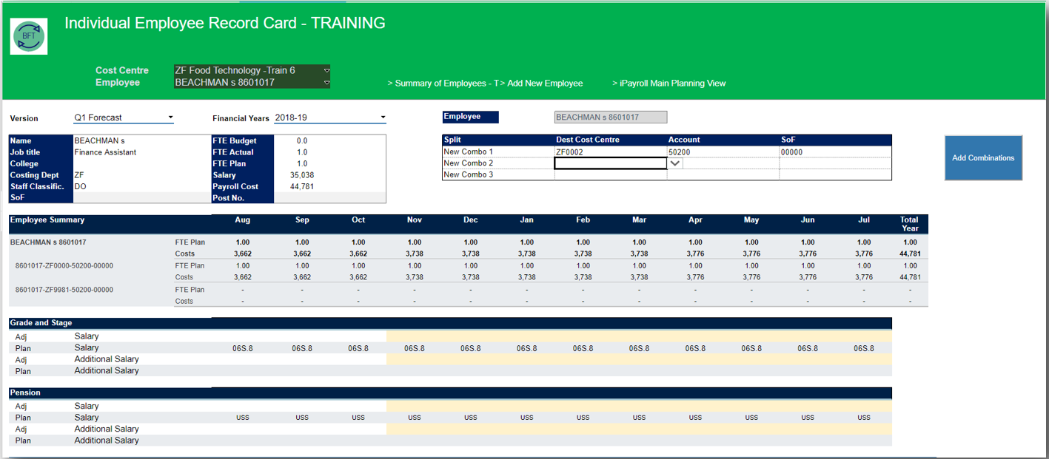
Staff Costs- BFT Employee Record Card
FTE Profile
Salary Costs
Cost Centre and Account
Grade
Pension Scheme
Notes:
This is an example of the Employee Record card in BFT for a fictional employee.
All changes to an individual can be made in the this window eg
FTE adjustments by month
Grade changes, outside the normal increment dates and
Cost centre or account changes, eg academic, research support
The BFT calculates pay for you based on a simple formula of FTE multiplied by grade. It automatically applies the appropriate pension, NI & yearly increments. You can manually enter any additional allowances if applicable
Once you have made changes in the BFT and carried out a final review, with your HR or Business manager, with commentary about any large variance since the last forecast. You can submit to your divisional finance team.

Slide 13
Staff costs- Departmental Case Study
Meeting with the relevant academic heads prior to budget setting helps to identify any new posts that need to be incorporated
It is really helpful to catch up with HR to ensure that any changes are captured. This includes new joiners, leavers, distinction awards, maternity/paternity leave and sabbaticals

Slide 14


Slide 15
Research Overheads
Research overheads are an income line that is generated through research activity.
These are generated as a proportion of costs on a project to cover indirect costs of research e.g. electricity, building costs, admin support etc.
The overhead rates are agreed with each funder and are managed by research accounts. Some projects do not generate any overheads.
Each Division has a Research overheads template that is sent out before the relevant reporting quarter. It details the overheads by project, and gives a method of projecting expected overheads. This is based on key dates and figures that pull from Oracle, such as the project end date and the budgeted overheads for each project.
This needs to be reviewed and adjusted where the department is aware of potential underspend, project extensions etc. Impacting the overhead recovery for the financial period
Awards about to start or awards not yet won are then added to the report to give a complete portfolio. You may wish to adjust these awards to reduce the expected overheads or build in delays depending on the likelihood that they will track as planned.

Slide 16
Research Overheads- Hints and tips
In our department we ensure that the Pre-award team is closely involved in assessing our pipeline. We apply a % chance of success to each application depending on how far along the pipeline a project is
It may be useful to break the portfolio down into different funder types or awards with similar profiles (mostly salary costs or with large one-off purchases). Then these awards can all be considered together.

Slide 18
JRAM
JRAM stands for Joint Resource Allocation Method and allocates out resources across the collegiate University. The main parts of JRAM are:
  Teaching JRAM 'T JRAM'
  Research JRAM 'R JRAM'
  Taxes and transfers
Teaching JRAM is supported by a Course Listing and includes the income earnt on all matriculated courses split between department and college.
Research JRAM is split between Charity, Business and Quality Related (QR) funding
Notes:
JRAM stands for Joint Resource Allocation Method and allocates out income across the collegiate University. It is split between research and teaching JRAM.
Teaching J RAM will include all income allocated to the department relating to matriculated courses. The model allows income for combined courses to be split by department.

Slide 19
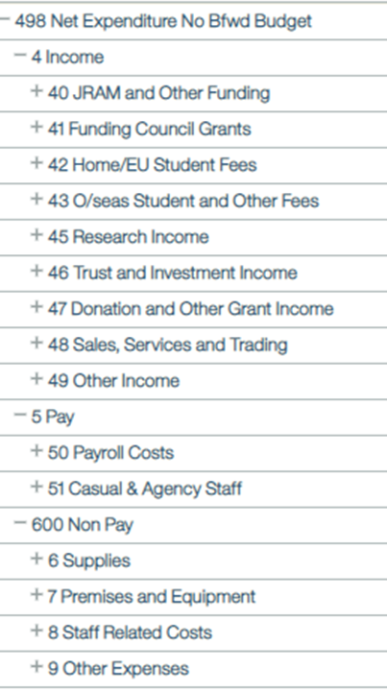

Slide 20
Trust Funds and Donation Income
The University receives income in the form of trust funds and donations
An individual or business may give money to the University in the form of a gift or donation. This needs to be assessed and the correct accounting treatment given. New donations can be difficult to predict but any deferred gifts already received should be included in the forecast to match spending.
Trust funds are held centrally by the University and reports sent to Departments regularly. These can be used to match expenditure. Any relevant spend included in the forecast should show matched income from the trust fund.
The reports from central finance can be used to determine how much money remains in each trust fund.

Slide 22
Other Income – Source of Funds
The University GL Account String is made up of:
Source of Funds (SOF) codes can help identify your department's unique income sources.
Both income and expenditure can be coded to SOF codes and this is mandatory in relation to trust funds and donations (Bxxxx & Cxxxx Codes)
SOF codes are organised in groups depending on their use; the first letter of the code indicates which group it belongs to:
  Axxxx = Medical Funding
  Bxxxx = Trust/endowment
  Cxxxx = Donations
  Dxxxx = Specific HEFCE funding
  Fxxxx = Scholarships
  Mxxxx = Examination Boards
  Pxxxx = Other income analysis
  Sxxxx = Departmental analysis
They are simple to set up and can be used as parameters when running reports
For a list of all existing SOF codes use this link and navigate to the chart of accounts https://finance.admin.ox.ac.uk/useful-documents-for-oracle-financials
Cost Centre | Account | Activity | Source of Funds | Organisation | Future
XX1234 | 12345 | 12 | X1234 (default 00000) | 12 | 000000
Notes:
Source of funds code on the GL string is used to identify income sources.
Income and expenditure can be coded to SOF codes and this is mandatory in relation to trust funds and donations.
The default SOF code is 0000.
But if the SOF begins with a letter, it indicates a source of income and the letter determines which group it belongs to.
You can budget and forecast income and expenditure in BFT at a SOF level.
Being able to filter and run reports on SOF codes can be really useful for month end accounting and forecasting
If a new SOF code is required, it is a simple process to complete a form, which can be found on the finance website.

Slide 23
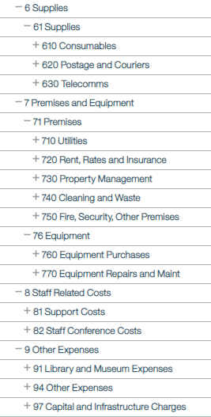


Slide 24
Other Expenses
Other expenditure lines may include building costs, training, travel etc.
It can be useful to look at historical information and look at normal run rates for building costs and utilities.
For staff related costs, there may be plans for travel or conferences that will need to be considered in more detail
Grants – the grants line may include various forms of student costs. Departments may need to consult with their student services teams to determine what costs are expected.

Slide 25
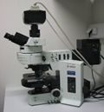
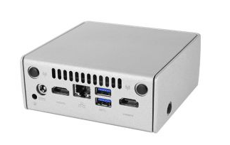
Supplies and Equipment
Type of Asset | Item | Cost | Life (years) | Accounting | Depreciation
Fixed Asset |  | £60k | >1 | the cost of the asset is charged to the I&E in equal monthly instalments spread over the life of the asset | monthly amount charged to the expenditure account across the whole asset life
Expense Asset |  | £20k | >1 | The entire cost is charged to the GL in the period of purchase | N/A
Externally Funded Equipment Purchases |  | £60k | >1 | income is fully matched to equipment cost in the month of purchase via a Trust Fund ​ | This is done centrally and will not affect your GL
Notes:
When the University purchases an unfunded asset >£50 with a life >1 year, it is capitalised and depreciated, that is, the cost of the asset and associated depreciation, is charged to the I&E in equal monthly instalments spread over the life of the asset.
The asset is placed on the University list of assets known affectionately as the (DEL) Departmental Equipment Listing.
The DEL is managed by the fixed asset team, and this is issued on a quarterly basis and includes the asset description, the number, cc, purchase date, month placed in service, and a depreciation figure
An Expense asset is less than £50K and the whole cost of the item is charged to the I&E in the month of purchase. It is not included on the DEL and it is not capitalised or depreciated.
Thirdly, Externally Funded assets are included on the DEL, but their accounting is done centrally and will not affect your I&E.
Fixed Assets: items of equipment - life > 1 year, are acquired for use in the operation of the University, =>£50k and are not intended for resale to customers
Expense Assets: items between £10k - £50k. The entire cost is charged to the GL in the period of purchase and tracked on the asset register & Departmental Equipment Listing (DEL)
Externally Funded Equipment Purchases: income is fully matched to equipment cost which is expensed in the month of purchase for equipment purchases funded from the A2 or B ledger or A1 ledger via a Trust Fund
Capitalisation: the cost of the asset is charged to the I&E in equal monthly instalments spread over the life of the asset (5 years or the remaining life of the project, whichever is shortest)
Depreciation: the monthly amount charged to the expenditure account for a capitalised asset; the sum of the depreciation charges across the whole asset life will equal the asset cost

Slide 26
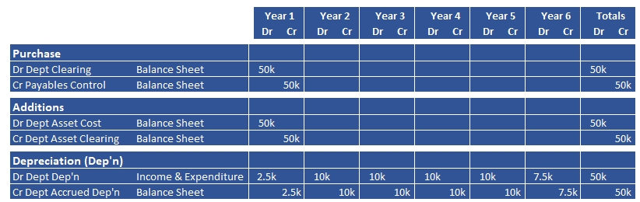
Depreciation of a £50k fixed asset - Departmental Case Study
A Department buys a microscope for £50k in May. The item is categorised as equipment and is depreciated over a period of 5 years (60 months). As the date placed in service is May, there will be 3 months depreciation charged in the first year. In the sixth-year depreciation with stop in April when the 60th month of depreciation is charged.
Notes:
This is an example of the accounting entries which accompany the purchase of a fixed asset – this illustrates, the depreciation being posted into the I&E, and what you might expect to see on your balance sheet.
You won't have to make any of these entries, they are taken care of centrally.

Slide 27
Supplies and Equipment
Department Responsibilities
Make sure you code equipment purchases correctly
Liaise with the central Fixed Asset Team to ensure internally funded asset details are correct
Check asset capitalisation information (DEL) provided by the Fixed Asset Team
Budget and forecast for existing assests in BFT for depreciation of capitalised assets using the (DEL) and for planned assets contact your divisional finance team
Fixed Asset Team Process
Fixed Asset Team picks up asset details on a monthly basis after the Accounts Payable and Projects module close (close of WD2)
Fixed Asset Team journals capital adjustments by WD6
The first month of depreciation is charged to the GL in that month and every month for the remaining life of the asset
Departments are sent a report showing Oracle accounting entries for the capitalisation adjustments made
The DEL is issued quarterly, listing all department assets (regardless of capital treatment or funding)
Notes:
The key to making sure that the University is capturing and accounting for its assets, is to make sure you correctly code equipment at the point of purchase.
If you are unsure, call the fixed asset team for advice
Check the DEL and notify the central team if any details are incorrect, such as wrong Cost Centre or life
For existing assets, use the DEL to forecast depreciation in BFT – for planned assets, you will have to calculate the depreciation off line or liaise with your divisional finance contact if you are unsure

Slide 28
Take a step back and consider..
Do the total movements align to my understanding?
  Does it make sense against actuals?
  Does it make sense against the last budget/forecast?
Do my A2 and B ledgers net to nil?
Do my income and expense lines look sensible line by line?
Have I captured everything that I have discussed in the department?
Does my FTE total look correct? Do I have any 'negative' people?
Is my phasing by month as accurate as possible?

Slide 29
Your Division is here to help
JRAM balances
Continuation charges and Visiting Student budgets
Research templates
Trust Fund balances
Service Charge, Space Charge & Contribution
Divisional recharges

Slide 30
Where does the forecast go next?
The forecast is used by different committees for different purposes
Department
PRAC
Division
Finance Committee & Council
Manage expenditure and reallocate resources if necessary
Identify risks and opportunities
Consider impact on University wider resource allocation and delivery of the strategic plan
Consider impact on University strategy, risk and financial sustainability

Slide 31
Useful links and who can help
BFT:
  IBM Cognos TM1 Web (ox.ac.uk)
BFT 'How To' training clips:
  BFT Training "How To's" | Finance Division (ox.ac.uk)
BFT Training map:
  BFT Training | Finance Division (ox.ac.uk)
Budget guidance notes are refreshed annually and include key budget assumptions:
  https://finance.admin.ox.ac.uk/files/2023-24budgetassumptionsguidancedocx
Your Divisional Team are a great starting point- if they don't know they will know who to ask
BFT support is available here (BFTSupport@admin.ox.ac.uk) but liaise with your Divisional Team first.

